Slide 1
Geometry 2, Keyboard Interaction, Booleans
Week 5.5
Notes:
"Before we dive into the structure of dynamic code, a really useful tool to have is commenting. Code can get pretty complicated so it is a good idea to leave notes for yourself to let yourself know what is going on."

Slide 2
Keyboard Interactions
keyPressed
keyPressed()
keyReleased()
key
keyCode & "CODED"
Notes:
When it comes to keyboard interaction it is both simpler and little more involved depending on what you want to do.

Slide 3
keyPressed vs. keyPressed()
if(keyPressed){
//Do something if ANY button is pressed
}
After Draw loop:
void keyPressed(){
//Do something every time ANY key is pressed
}
Notes:
These are identical to the mousePressed variations. One is a variable while the other is a function.

Slide 4
keyReleased()
if(keyReleased){
//Do something if ANY button is released
}
Notes:
Once again, keyReleased works similar to mouseReleased

Slide 5
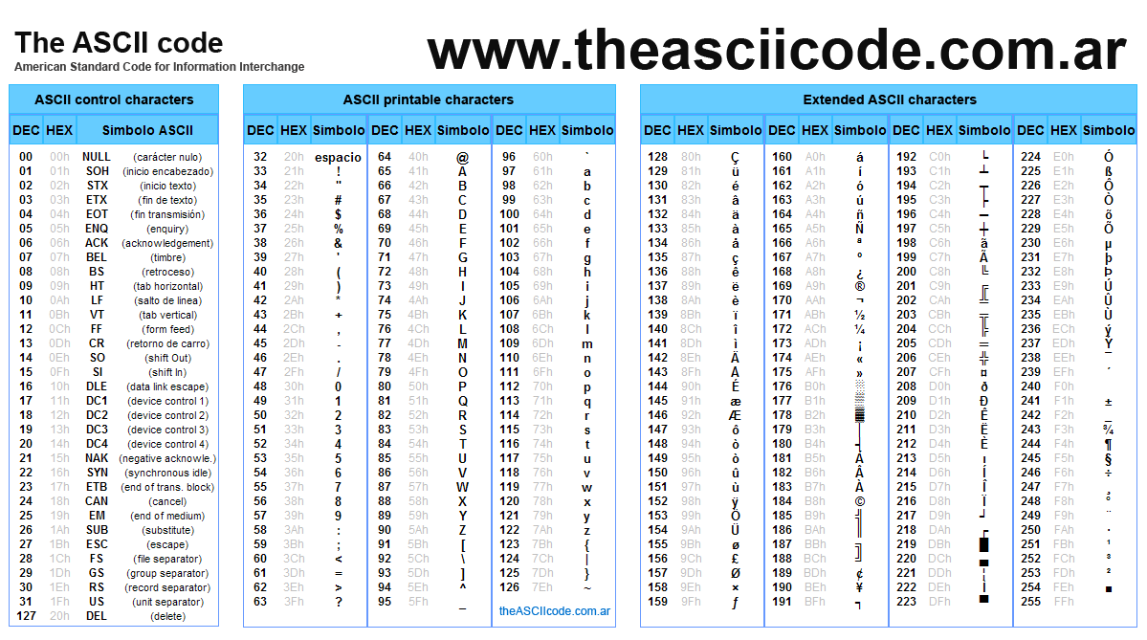
Which key???
Notes:
The real benefit of using a keyboard is that we can get lots of data from the user because there are so many keys they can press.
However, in order to understand which key is being pressed, we need to understand something known as ASCII code (pronounced ask-ee). As you all probably know, computers only understand numbers, specifically ones and zeros. So, in order for us to understand key presses, we need to understand that some keys have an ASCII code and others do not. Luckily for us, we do not need to remember the specific number codes for each letter because Processing has made it very easy. However, we do need to recognize that some keys are not coded for so we need to identify them a slightly different way.

Slide 6
ASCII vs. Non-ASCII
ASCII
26 letters of the alphabet
Case sensitive (e.g. A = 65, a = 97)
BACKSPACE, TAB, RETURN, ENTER, DELETE, ESC
Non-ASCII
UP, LEFT, RIGHT, DOWN arrow keys
ALT, CONTROL, SHIFT
Notes:
There are other keys on the keyboard that are not included in this list, but these are most of the keys you will actually use for user interactions.

Slide 7
ASCII Keys
if(keyPressed){
if(key == 'e'){
//Do something if e key is pressed
}
}
Notes:
For ASCII encoded keys, all you have to do is check the variable "key" to see what it contains after you have checked for a button press.

Slide 8
Non-ASCII Keys
Use keyCode and CODED
if(keyPressed){
if(key == CODED){
if(keyCode == UP){
//Do something if UP arrow is pressed
}
}
}
Notes:
Like I said before, pretty much all the hard work is done by processing so if we want to access keys that are not ASCII coded we just need to check to use a different variable.
When looking for non-ascii keys, check to see if key is "CODED" first, then proceed using keyCode instead of key.

Slide 9
ASCII and Non-ASCII Keys
if(keyPressed){
if(key == CODED){
if(keyCode == UP){
//Do something if UP arrow is pressed
}
} else {
if(key == 't'){
//Do something if t is pressed
}
}
}
Notes:
Naturally, if we want to use both coded and non coded keys in our sketch we just need to use an else condition to specify what to do if the key is not coded.

Slide 10
Review Conditionals
if (hungry){
EAT FOOD;
}
else {
DO NOT EAT;
}

Slide 11
if (hungry){
EAT FOOD;
if(sleepy && nearBed){
GO TO SLEEP--YOU ARE IN A FOOD COMA;
}
}
else {
DO NOT EAT;
if(thirsty || dehydrated){
DRINK SOMETHING;
}
}

Slide 12
Boolean variables
Can only hold one of two possible values:
true
or
false
Notes:
Can think of as 0/1 or yes/no

Slide 13
boolean b = true;
b = !b;
println(b);
Notes:
NOT operator is represented with "!" basically reverse the value of a BOOLEAN

Slide 14
Notes:
ACTIVITY 01 ( 05 minutes )
- Break in pairs
- Think of an important decision:
- examples: expiration date on milk... how to proceed after that to re-check, how to cross the street, how to know if you want to ask somebody for a date,
- inspiration https://www.google.com/search?q=decision+flow+charts&tbm=isch&tbo=u&source=univ&sa=X&ei=A1fYUdnSH6224APokoDoDw&ved=0CDAQsAQ&biw=1333&bih=775
- Break it in small YES/NO steps
- Make a FLOW CHARTS of it
- Translate it to code

Slide 15
boolean a;
boolean b;
if (a == true) {
if (b == true){
// a && b
} else {
// a && !b
}
} else {
if (b == true){
// !a && b
} else {
// !a && !b
}
}
Notes:
One of the most powerfull things on computation is that you can nest statements to develop more complex logics.
SEE EXAMPLE

Slide 16
Boolean
NO / false
YES / true

Slide 17
boolean a = ;
boolean b = ;
if (a) {
if (b){
// Outcome 1: a && b
} else {
// Outcome 2: a && !b
}
} else {
if (b){
// Outcome 3: !a && b
} else {
// Outcome 4: !a && !b
}
}
}
3
A
B
4
B
2
1
Notes:
One of the most powerful things about computation is that you can nest statements to develop more complex logic.
Why this is important??
SEE EXAMPLE

Slide 18
Everything on the digital field is just a bunch of 0 / 1 computed in a logical way that makes sense of it.
Data vs. Process
Notes:
That's applied to text and images

Slide 19




rectMode(CORNER); ← default
rectMode(CENTER);
ellipseMode(CENTER);
ellipseMode(CENTER);

Slide 20



Arc
arc(a, b, c, d, start, stop)
arc(a, b, c, d, start, stop, mode)
arc(50, 50, 80, 80, 0, PI+QUARTER_PI, OPEN);
arc(50, 50, 80, 80, 0, PI+QUARTER_PI, CHORD);
arc(50, 50, 80, 80, 0, PI+QUARTER_PI, PIE);

Slide 21
Geometry
And a few constants that will come in handy:
because...
Processing uses radians rather than degrees.
PI
QUARTER_PI
HALF_PI
TWO_PI

Slide 22

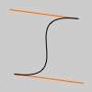
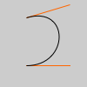
Curve
curve(5, 26, 5, 26, 73, 24, 73, 61);
curve(5, 26, 73, 24, 73, 61, 15, 65);
curve(73, 24, 73, 61, 15, 65, 15, 65);
curve(x1, y1, x2, y2, x3, y3, x4, y4)
curve(x1, y1, z1, x2, y2, z2, x3, y3, z3, x4, y4, z4)
Bezier
bezier(85, 20, 10, 10, 90, 90, 15, 80);
bezier(30, 20, 80, 5, 80, 75, 30, 75);
bezier(x1, y1, x2, y2, x3, y3, x4, y4)
bezier(x1, y1, z1, x2, y2, z2, x3, y3, z3, x4, y4, z4)

Slide 23
Complex shapes
beginShape(MODE);
Begin the shape with the specified mode
- modes like triangles, triangle strip, triangle fan, quads, quad strip, lines, etc.
vertex(x, y);
Add a point to your shape
endShape();
End/close the shape

Slide 24

Review Buttons
y
x, y
mousex, mousey
y + rectHeight
x
x+rectWidth
If all these conditions are true, the mouse is over the object

Slide 25
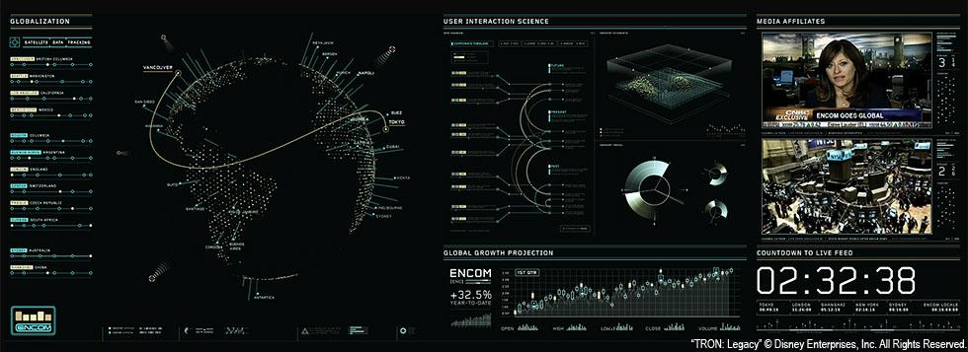
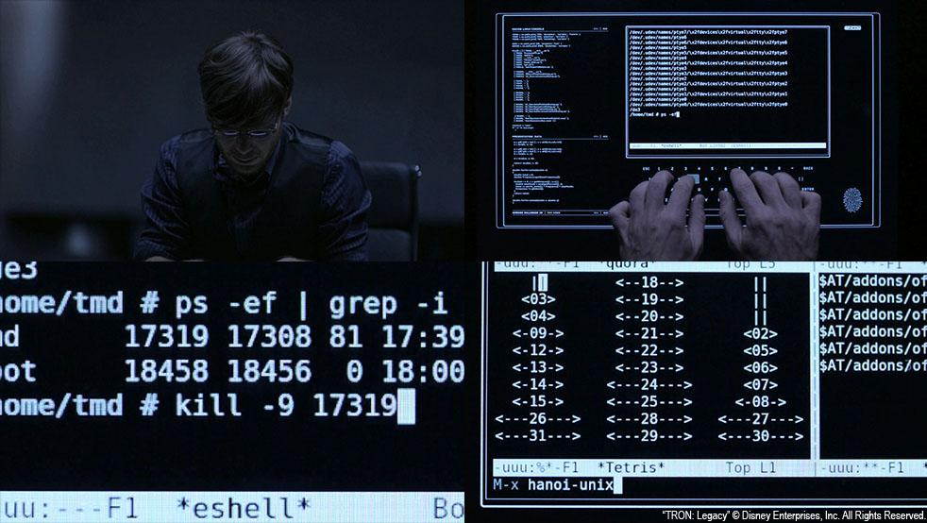
Homework
Cyberpunk Tennis
Notes:
IMPORTANT: THIS IS A MOCKUP !!!

Slide 26
Using Tennis for Two and Tron as inspiration, make a pong style interactive sketch using hover states, mouse clicks and key presses. Try to get as many of the interactive elements functioning as possible and leave detailed comments regarding what challenges you continue to face.

